Slide 1

Team Hindsight
Design Review I

Slide 2
Introduction
Hunter Rainen - Team Lead, Documents/Research Alexanderia Nelson - Release Manager, Documents/Research Adam Paquette - Architect , Coder Charles Beck - Recorder, Coder
Client: Iona Brockie NASA\JPL - Caltech
Faculty: Dr. Doerry
Mentor: Austin Sanders
Notes:
< 1 minute

Slide 3
Problem Statement - Mars 2020 (M2020) Mission
The main objective of the Mars missions, are to find evidence of past life on the Martian surface.
This mission, M2020, takes the next step by not only seeking signs of habitable conditions on Mars in the ancient past, but also searching for signs of past microbial life itself. - JPL
JPL’s latest Mars rover will have a suite of tools for discovering a variety of scientific information. One tool that directly affects Team Hindsight’s project is a drill. The rover will drill holes into rocks on Mars so that other instruments like PIXL and SHERLOC can further analyze with finer detail the composition of the Martian surface.
PIXL: Planetary Instrument for X-ray Lithochemistry
SHERLOC: Scanning Habitable Environments with Raman & Luminescence for Organics & Chemicals
Notes:
About 2 - 5 minutes for entire section
Begin with overall business area JPL is in
Introduce the area
Briefly explain how it works
Give some motivating info on how big/active/important that sector is
How many people are involved

Slide 4
Problem Statement Cont. - Mars 2020 Mission
However, the process of drilling into rocks creates dust in and around the hole.
This dust obscures the mineral and chemical makeup of rocks which the scientific instruments on board the rover are trying to analyze
JPL’s current solution is to blow a puff of air into the hole (via compressed gas) to blow out any dust.
Iona needs to know how effective this gas dust removal tool is at getting the dust out of any particular hole the rover might drill.
Notes:
About 2 - 5 minutes for entire section
Begin with overall business area JPL is in
Introduce the area
Briefly explain how it works
Give some motivating info on how big/active/important that sector is
How many people are involved

Slide 5
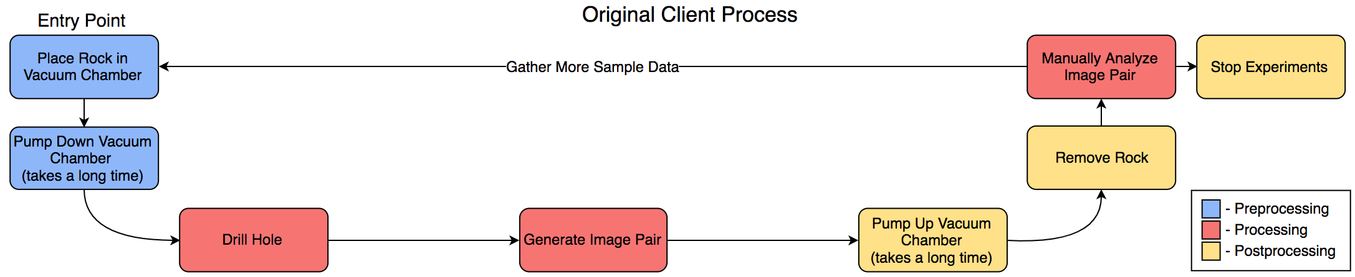
Problem Statement - What’s Wrong
Fig 1. Diagram of JPL’s original process for gathering data
Testing Dust Removal System
Current Process
Slow process to simulate Martian atmosphere (requires vacuum chamber)
Lots of Data to analyze (JPL takes measurements from many sensors for each test)
Inaccurate (Human error)
Conflicting results (Two different humans may come up with different answers)
Tests can be invalidated (removing the test slab from vacuum chamber may disturb dust)
Notes:
Describe what’s broken/why we were hired
Describe it in overall terms briefly
Get down to a bulletting out a few specific things that are not satisfactory

Slide 6
Solution Overview
Image Processing Pipeline
Takes in a pair or pairs of images (before and after images of an abrasion)
Apply user/programmer defined algorithms to all pairs of images automatically
Same algorithms result in a consistent analysis
Output regionally defined image and associated data
Output Image
Clearly defines dust coverage
Associated Data
Hard percentages for each region
Notes:
Solution Overview.
Our solution for JPL’s problem is an image processing pipeline.
Some of the specific features for this pipeline include:
Taking in one pair or multiple pairs of images that JPL generates for a particular abrasion
Apply both user defined or programmer defined algorithms to said sets. We will be providing JPL with a set of algorithms to do dust detection but this will allow the engineers at JPL to use the tool as they see fit.
Output some kind of regional distinction between heavily dust covered, moderate to light dust coverage and no dust. This is will be done in two ways:
One with clearly defined regions using color coding to visually distinguish the coverage
The other with a percentage for the given regions for how covered that region is in dust

Slide 7
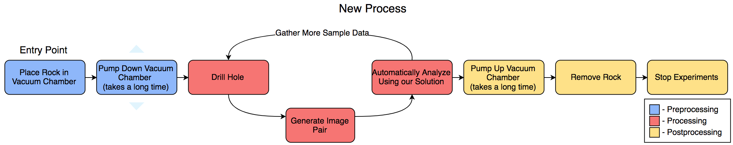
Fig 2. Diagram of the new process with our solution
Fig 3. Diagram of JPL’s original process for gathering data
Notes:
Above are two processes, the first being the new process with our solution integrated into JPL’s testing process. The other being JPL’s old process that we showed earlier.
As you can see, JPL’s current process does not clearly decouple the preprocessing, processing, and postprocessing of their image sets. This results in their test gathering loop including unnecessary steps that should only be done once. The main two being the Pumping up and Pumping down of vacuum chambers.
In the new process, our solution will eliminate these redundant steps and make a more streamlined and easier to handle system. It will clearly define a preprocessing phase, processing phase, and postprocessing phase. This will make our clients testing process much easier and allow them to focus more on gathering and analyzing data instead of running pre and post processing steps for every set of data that is collected.

Slide 8
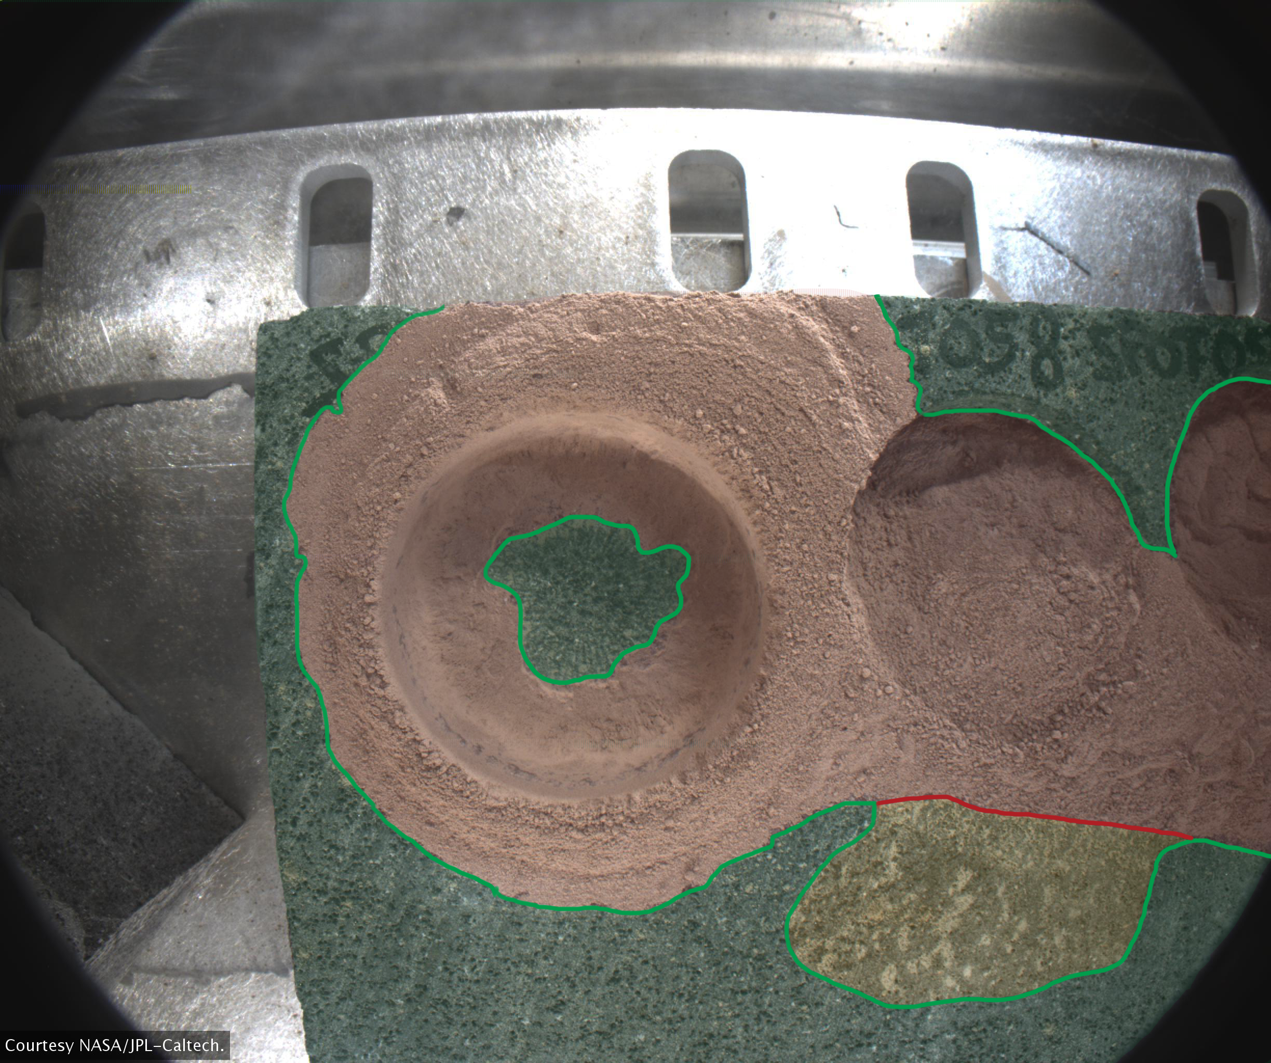
Key Requirements - Functional
Handle Batches of images
Select folder of images and run through program
Analyze image(s) for dust
Mark areas of dust coverage
Green
Yellow
Red
Allow user to adjust parameters.
Figure 4 took 30-40 minutes to hand make
Fig 4. Example abrasion analysis
Notes:
About 3 minute
Begin by mentioning (briefly) how you got these requirements (This might be better spoken than as a bullet point on the slide)
Present key requirements that you system must meet from the domain perspective
This just means expressed in terms from the client’s end domain, rather than in the more structured/technical function performance requirements we’ll do to next
Most projects can summarize the key requirements in about 5-10 bullets. Briefly explain each one

Slide 9
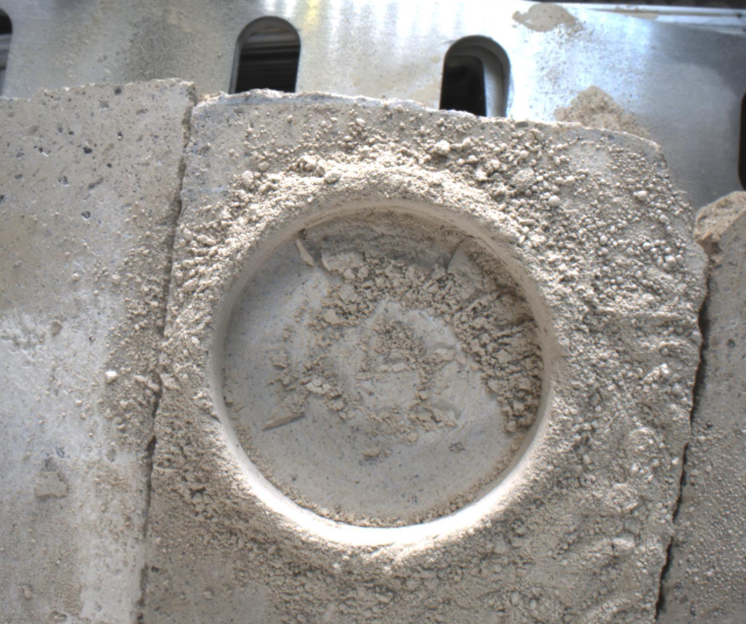
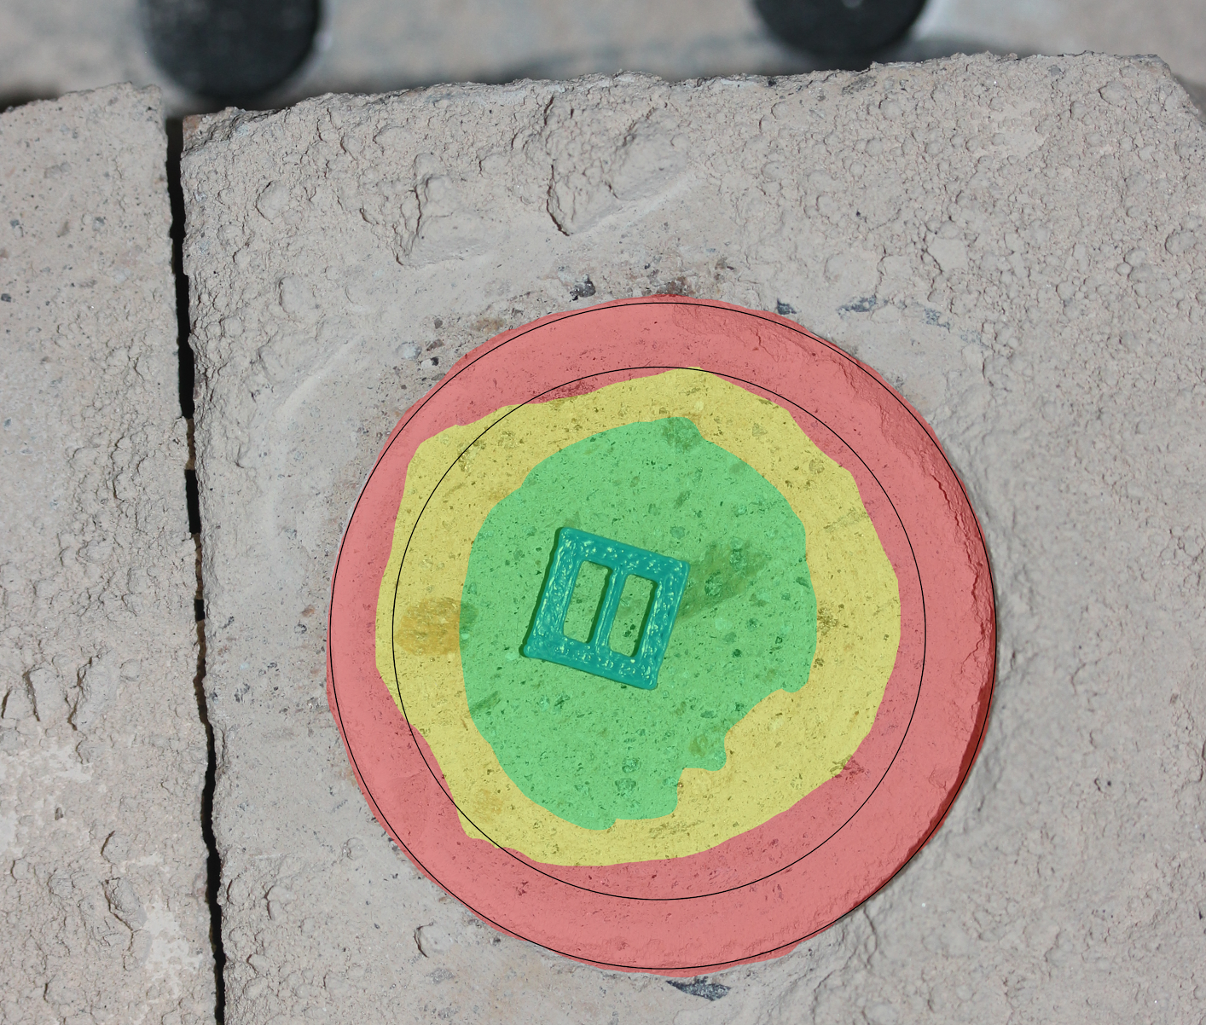
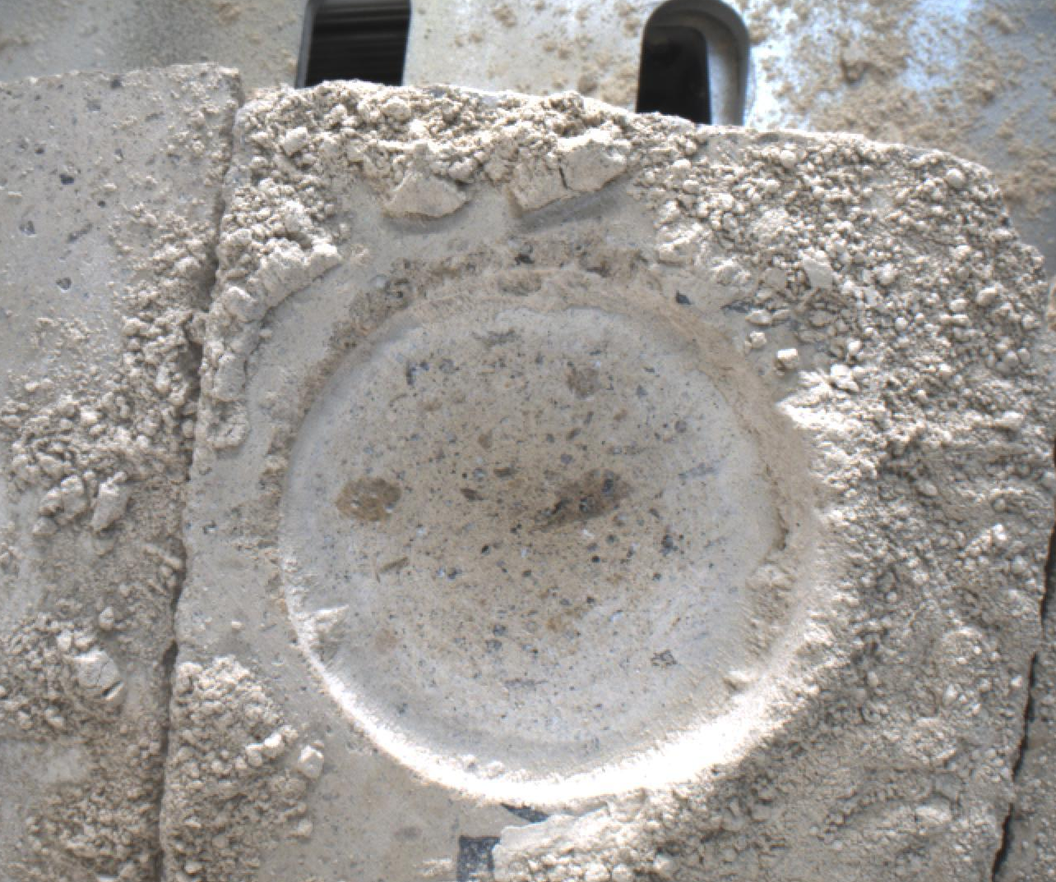
Key Requirements - Non-Functional
Display percentage of areas cleared
Green = 70%-100% area of abrasion free of dust
Yellow = 40%-69% area of abrasion free of dust
Red = 0%-39%
Display before air blast, after air blast, and analyzed images in a GUI
BEFORE
AFTER
ANALYZED
Fig 5. Examples of a before, after, and JPL analyzed image
Should take no longer than a minute per image pair

Slide 10
Risks
Potential risks we foresee running into:
Inaccurate algorithms
dust can be similar in color to rocks (hard to distinguish between the two)
Likelihood: Possible to occur, Moderate
Slow Run Time
Algorithms looking at large images (~ 2448 pixels × 2048 pixels)
Moderately sized image sets (2 - 10 images)
Likelihood: Not very likely

Slide 11
Risks Continued
Potential risks we foresee running into:
Comparing the wrong set of images
Variations of naming conventions.
Likelihood: Not very likely
Costing JPL testing time
May lose more time using their original method of testing.
Even if we ship an incorrect product, JPL has planned this mission without the involvement of our software and will complete their testing in their designated time.
Likelihood: Not very likely

Slide 12
Mitigation
Mitigate inaccurate algorithms
First: Take multiple (50px x 50px) samples
Second: Comparisons of what our programs sees as dust and what we have sampled as dust to validate results
Third: Stochastic Modeling
Mitigate slow runtimes:
First: Subdividing large images
Second: Use less changes to images
Third: Integrate Parallelism
To shorten our program’s runtime, we will likely port to a faster language (eg. C++).

Slide 13
Mitigation Continued
Mitigate comparing the wrong images:
First: Have a confirmed naming convention agreed upon by JPL and our team
Mitigate costing JPL test time:
First: Compare their original results of JPL’s analyzing to our programs results and confirm correctness.
Second: Refine results with better modeling techniques
Third: Vast testing, refinement, user testing
Section 3.1.3 and 3.2.3 in our Technical Feasibility document explains more options in greater detail.

Slide 14
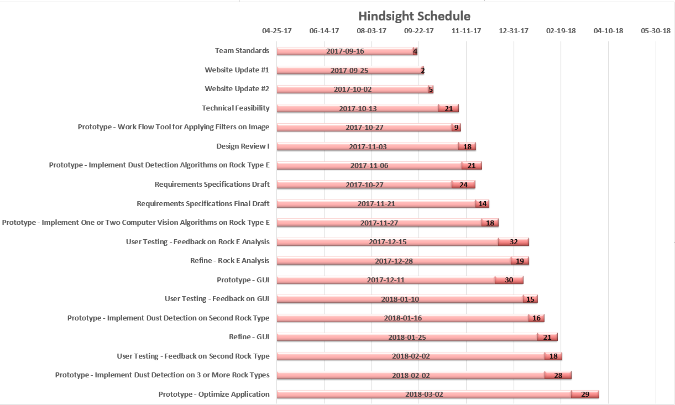

Schedule
Now
Notes:
This is our schedule based on our current progress. We are working on implementing dust detection algorithms on Rock Type E, which our client suggested would be the easiest to work with out of the five types, and working on our final draft of our Requirements document.
Leading up to the Spring semester, we plan to implement one or two computer vision algorithms on Rock Type E and have JPL test our current prototype of analyzing Rock Type E to get feedback on it. We'll also be working on a prototype of a GUI that we will also have JPL give feedback on as well.

Slide 15
Conclusion
Client and Problem
Our Solution Vision
Take in batch of images
Automatically apply computer vision algorithms to detect dust
JPL can then run multiple tests in a single vacuum chamber pump down session
And get feedback on how effective their gas Dust Removal Tool is
Key Topics
Requirements Acquisition
Functional and Non-functional Requirements
Risks and Feasibility
What’s Coming Up for Team Hindsight
Notes:
To summarize this talk, we are Team Hindsight and our client is Iona Brockie, a mechatronics engineer at JPL, who is one of the people working on the Mars 2020 rover mission to discover if there was past life on Mars. To solve their problem of testing the effectiveness of their gas Dust Removal tool and speed up the testing process, our program will be able to take in a batch of images, automatically apply computer vision algorithms, and allow JPL to run multiple tests in a single vacuum chamber pump down session and get feedback on how effective their tool is.
The key topics that we discussed in this Design Review were: how we acquired our requirements through client meetings and email; the key requirements we gather from those meetings, which will be further explored in our upcoming Requirements document, and the possible risks we might encounter through our development phase and how we plan to mitigate those risks should we encounter them.
The next steps for our team are creating more prototypes on the different rock types after we have a working prototype for Rock Type E, having JPL test our prototypes and get feedback so we can refine the program and creating a GUI to allow JPL to modify the algorithms.
Finally, this tool will save JPL a lot of time testing their Dust Removal tool on their Mars 2020 rover so it can succeed at its goal of detecting whether there was past life on Mars. Thank you. Are there any questions?

Slide 16
Questions?

Slide 17
Sources:
https://mars.nasa.gov/mars2020/mission/overview/

